Slide 1
V3.0.0
New Features and Process

Slide 2
Enhancements
In V3.0.0 we upgraded and cleaned:
Inventory, Customer and Invoice searches
Item Imports
New features:
Extensive Invoice Report
Adding new Brands and Models

Slide 3
Inventory, Invoice and Customer Searches
All three processes were updated to provide faster, and more accurate results
Testing the inventory searches: With the updated search method, we can search for TaylorMade and return 5410 results in approximately 8 seconds. With the current method it took 61 seconds to return 5808 results.

Slide 4
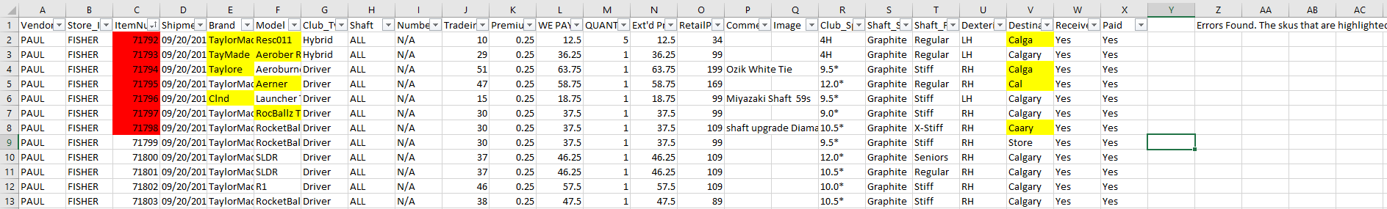
Item Imports
With the updated method of importing items, there will be a much smaller chance of an error or missing inventory happening. As part of the process, all fields that should contain a number are checked to make sure that a valid number is located. If the list passes this check, it will go on to the next check which will check the model, brand and location. If any of these are not found in the database, a downloadable excel sheet will be created that will highlight any fields that are causing issues.
Causes for error can be spelling mistakes, blank fields, or it is not in the database
Notes:
What do you mean that: “it is not in the database”? Isn’t one of the reasons to import is to add a new item to the database?

Slide 5
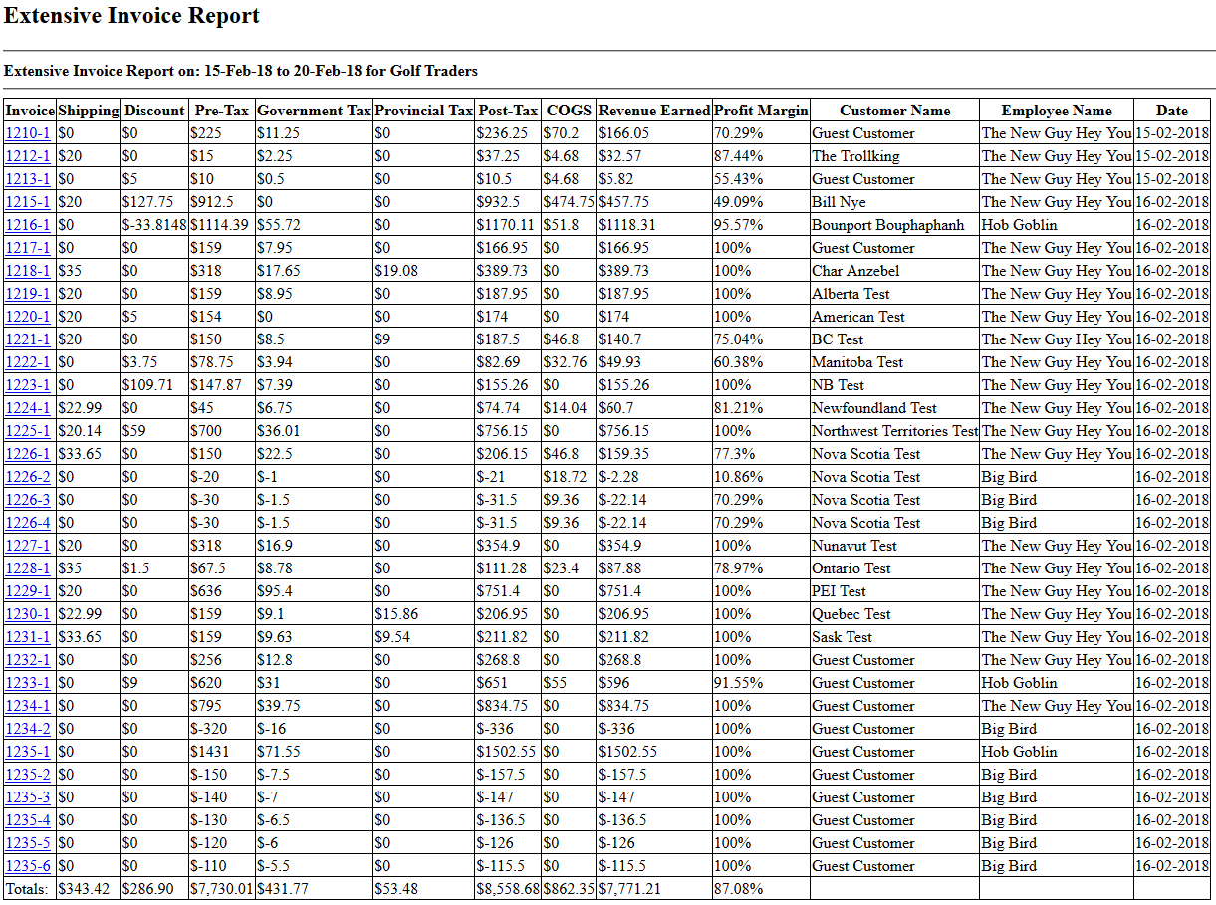
Extensive Invoice Report
This report takes a look at each invoice between two dates and the selected location to provide useful information such as COGS, revenue earned, and the profit margin of the invoice.

Slide 6
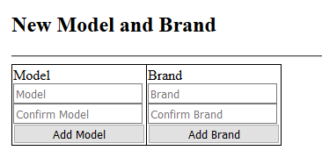
Adding Brands and Models
You can now add brands and models via the Settings page. The user must type in the new brand or model twice to prevent spelling errors.

